Slide 1
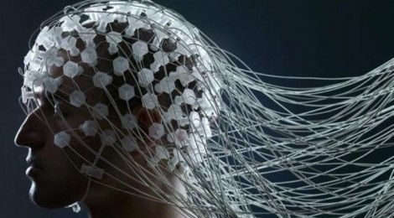
Removal Of Ocular Artifacts From Electro-encephalogram by Adaptive Filtering
Giri Balasubramanian
University Of Illinois At Chicago
Fall 2017
Notes:
About a month back, I presented this paper. I tried to execute the same algorithm on Matlab for my project for this course.
I took the same slides and added a project section.
I go over the slides quickly that I showed the last time and spend majority of my time on the actual Matlab execution

Slide 2
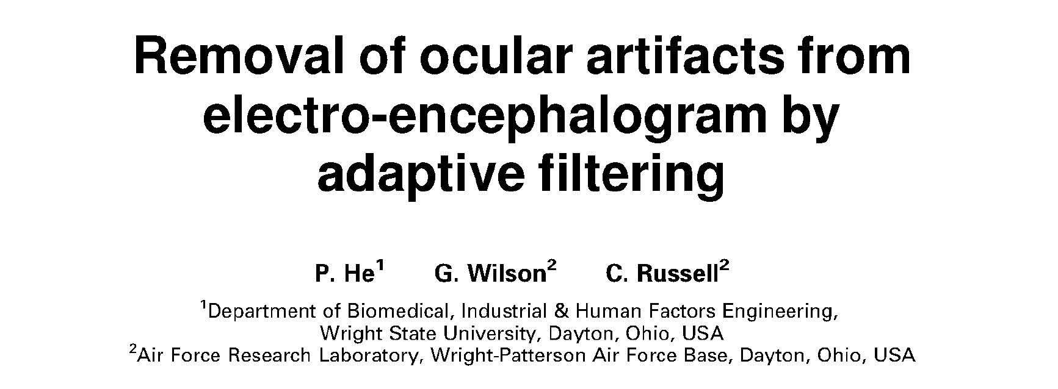
Work Based On
Removal of Ocular Artifacts from EEG by Adaptive Filtering

Slide 3
Table of Content
Introduction – Focus of this paper
Theory
Project
Conclusion

Slide 4
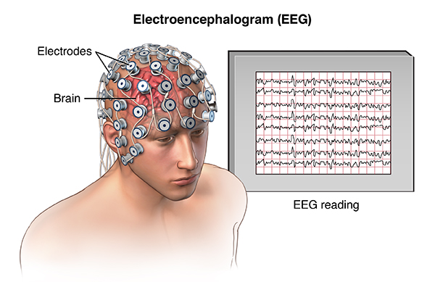
Introduction : EEG
EEG (Electro-encephalography) is a technique for measuring or recording electrical activity of the brain caused by firing of neurons in the brain. This measurement is done using electrodes.
Getting the right EEG is important cause it is useful for -
  Clinical diagnosis and treatment: ALS, Seizure, Neurofeedback Therapy
  Biomedical Research: Neural Encoding

Slide 5
A Problem: EOG corrupts EEG signal
The eye forms an electric dipole, where the cornea is positive and the retina is negative. When the eye moves (saccade, blink or other movements), the electric field around the eye changes, producing an electrical signal known as the electro-oculogram (EOG).
As this signal propagates over the scalp, it appears in the recorded electro-encephalogram (EEG) as noise or artifacts that present serious problems in EEG interpretation and analysis.
Previous studies (CROFT and BARRY, 2000) have shown that there are at least two kinds of EOG artifact to be removed:
  Those produced by the vertical eye movement (the corresponding EOG is called VEOG)
  Those produced by the horizontal eye movement (HEOG)
  This paper focuses on denoising these two types of artifacts using adaptive filtering

Slide 6
As is Situation
To correct or remove ocular artifacts from EEG, many regression-based techniques have been proposed,
Simple time-domain regression (VERLEGER et al., 1982; GRATTON et al., 1983),
Multiple-leg time-domain regression (KENEMANS et al., 1991) and
Regression in the frequency domain (WHITTON et al., 1978; WOESTENBURG et al., 1983).
Independent Component Analysis(JUNG et al., 2000)
These methods require
Off-line analysis and processing of data
Data needs to be collected from a sufficiently large number of channels,
It works only when the correct noise components are identified
Notes:
In all these regression-based approaches, calibration trials are first conducted to determine the transfer coefficients between the EOG channels and each of the EEG channels (CROFT and BARRY, 2000). These coefficients are then used later in the 'correction phase' to estimate the EOG component in the EEG recording for removal by subtraction.
Independent component analysis (ICA) has been proposed to separate the EGG signals from the EEG signals.

Slide 7
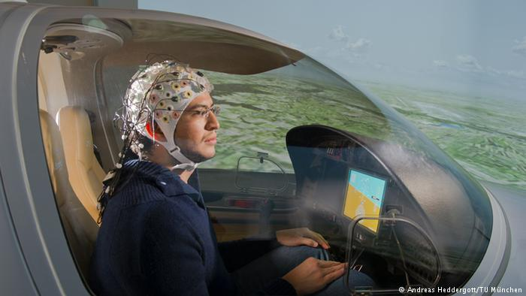
Some Applications Need Online Analysis
When the applications require real-time removal of ocular artifacts, or when the calibration trials cannot be conducted owing to various constraints, the methods described above become unsuitable.
For example, researchers are developing methods for accessing a pilot's functional state during flight, so that adaptive aid can be provided in the case of mental overload.
As the pilot's activity is accompanied by a significant amount of eye movement, either voluntarily or involuntarily, EOG contamination is a serious problem in EEG-based analysis.

Slide 8
Table of Content
Introduction
Theory – Formulation
Project
Conclusion

Slide 9
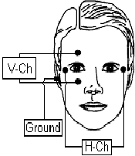
New Approach: USE Adaptive Filter
The paper describes a method for removing ocular artifacts for EEG using adaptive filtering.
The method is implemented using Recursive least-squares (RLS) algorithm, because
  Does not require calibration trials.
  EOG artifacts can be removed on-line.
  Superior stability.
  Fast convergence.
This method uses separately recorded vertical EOG and horizontal EOG signals as two reference inputs.

Slide 10
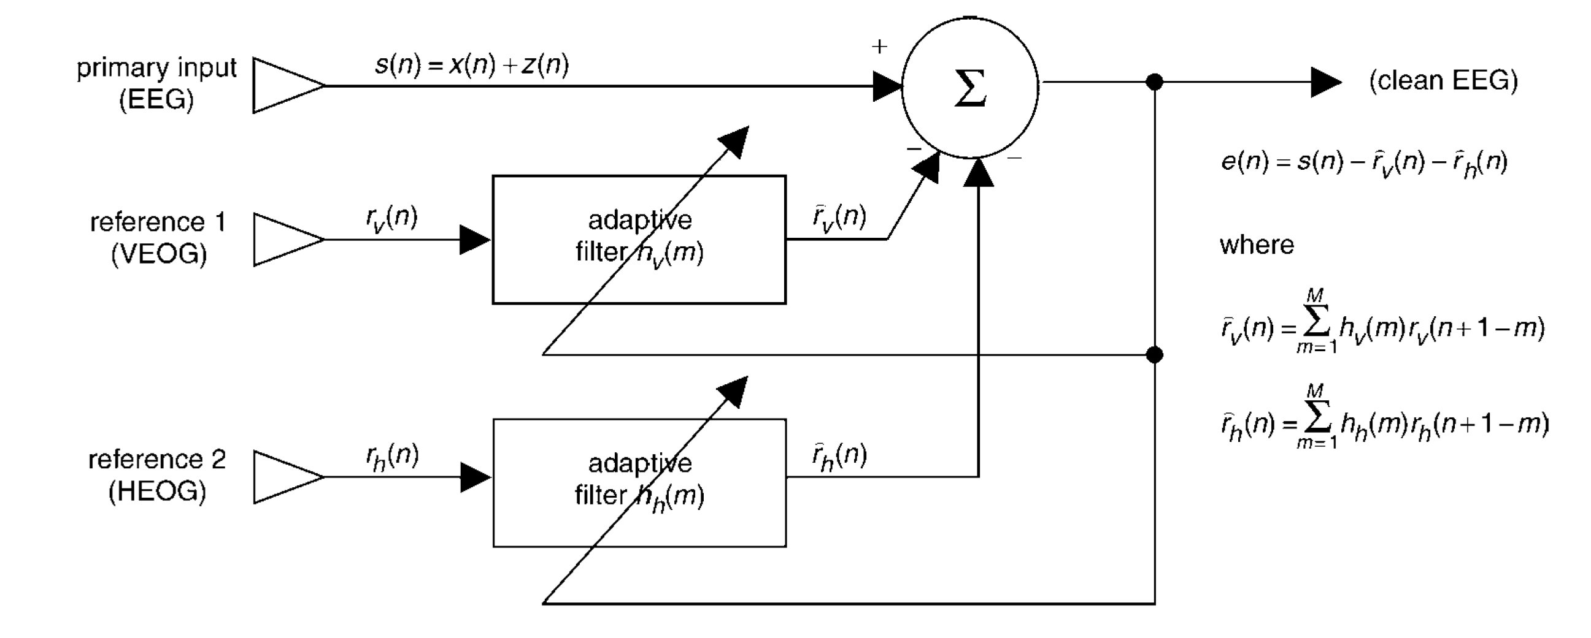
System Design
Each reference input is first processed by a finite impulse response filter of length M and then subtracted from the original EEG.

Slide 11


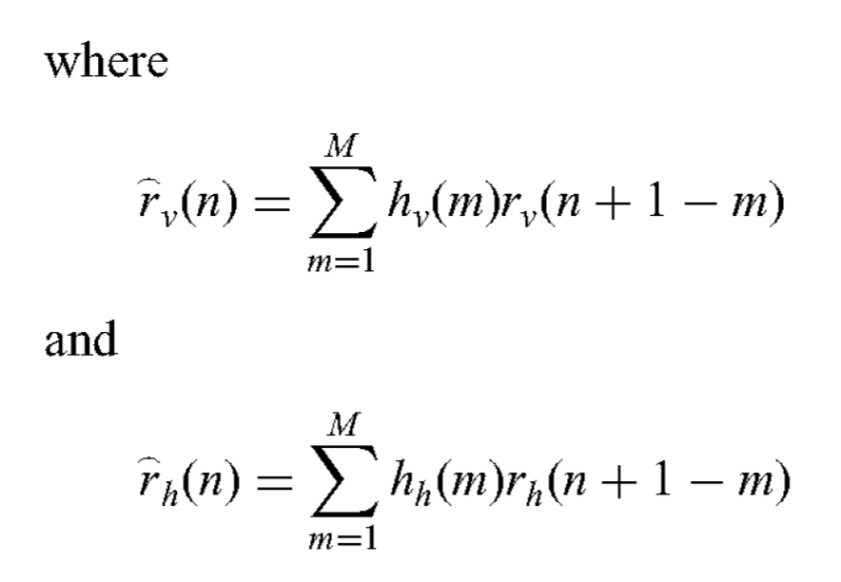
Error Signal
The goal of the noise canceller is to produce an output signal e(n) that is as close to x(n) as possible, by adjusting the filter coefficients h_{v}(m) and h_{h}(m)

Slide 12
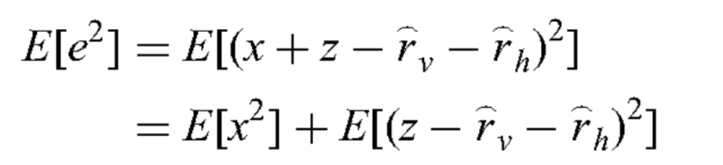
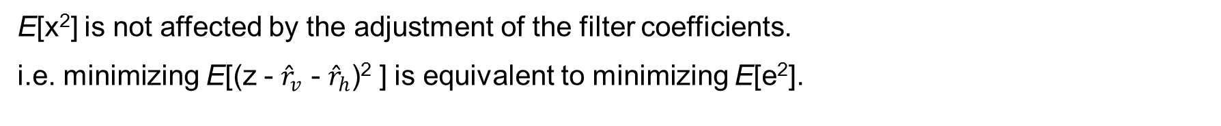
MSE Criterion
We use MSE criterion for filter optimization.
i.e. min E[e²], where
E[x²] is not affected by the adjustment of the filter coefficients.
i.e. minimizing E[(z - ${\hat{r}}_{v}$ - ${\hat{r}}_{h}$)² ] is equivalent to minimizing E[e²].
Notes:
All this theory needs all the statistics of eeg and eog, which is not possible most of the times. That’s why, we try to substitute this criterion with an estimate as shown

Slide 13
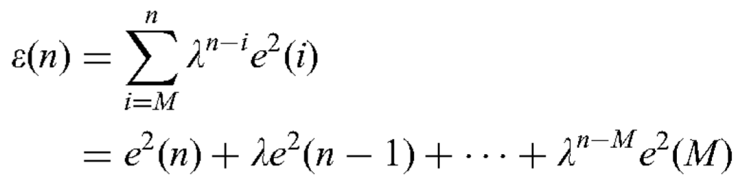
Equivalent Target Function
Assuming at time t, we have obtained the following samples: s(i), r_{v}(i), r_{h}(i) and e(i),
for i = 1, 2 , . . . , n
We form the following target function Ɛ(n) to minimise:

Slide 14
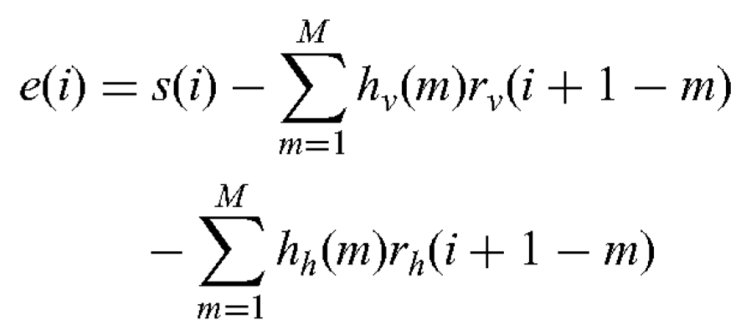
Equivalent Target Function (Cont.)
Target function Ɛ(n) to minimize:

Slide 15
Equivalent Target Function (Cont.)
Target function Ɛ(n) to minimize:
By minimizing Ɛ(n) instead of E[e²], we simply use the sample mean to approximate the expected value.
In addition, by introducing the forgetting factor λ, the algorithm can also be applied to a random process that is not strictly stationary.

Slide 16
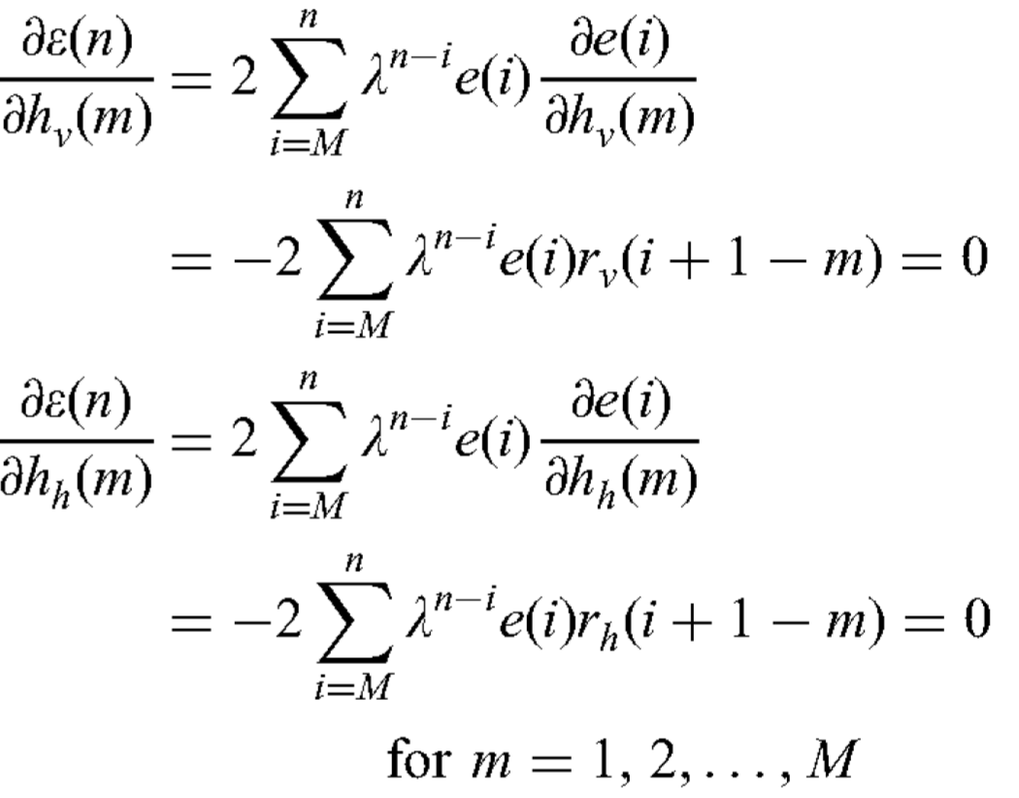
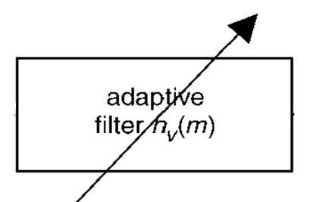
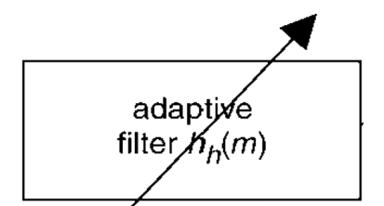
Coefficient Optimization
The filter parameters h_{v}(m), h_{h}(m), m= 1,2,... ,M, that minimize Ɛ(n) can be obtained by solving the following two sets of equations. (In total 2M equations)

Slide 17
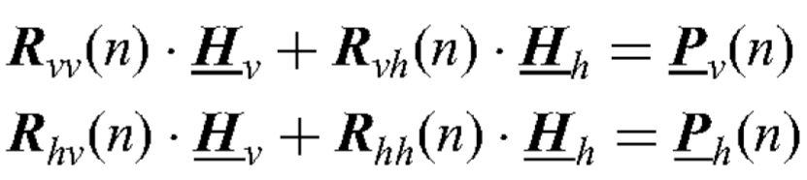
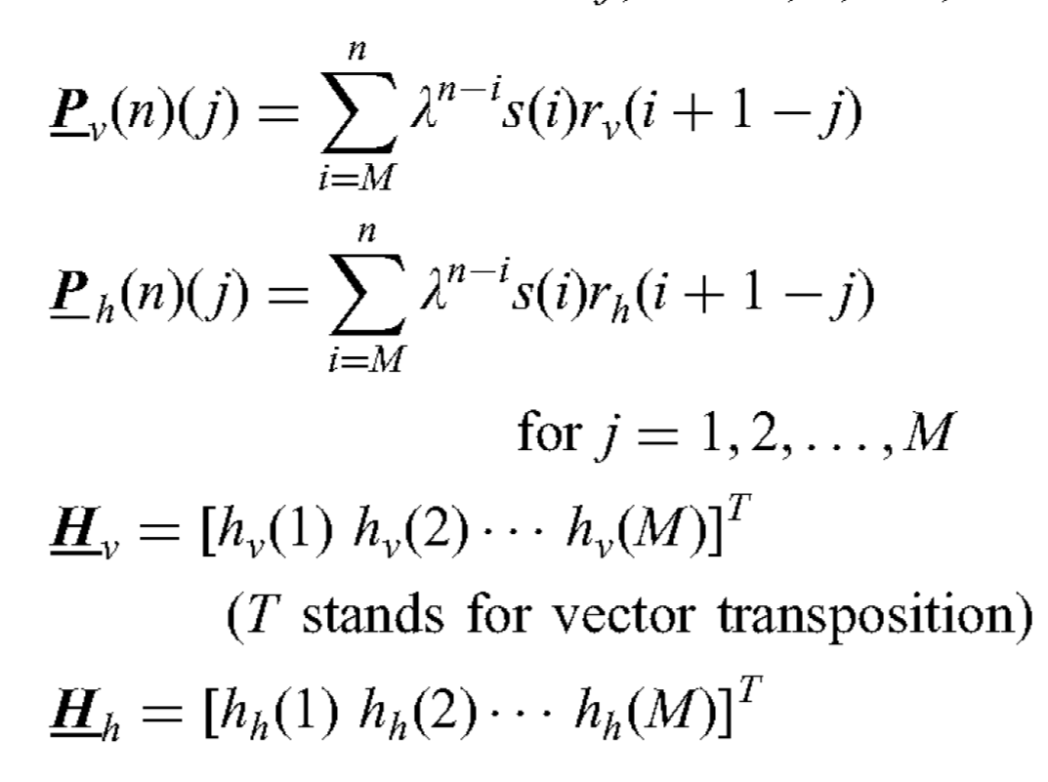
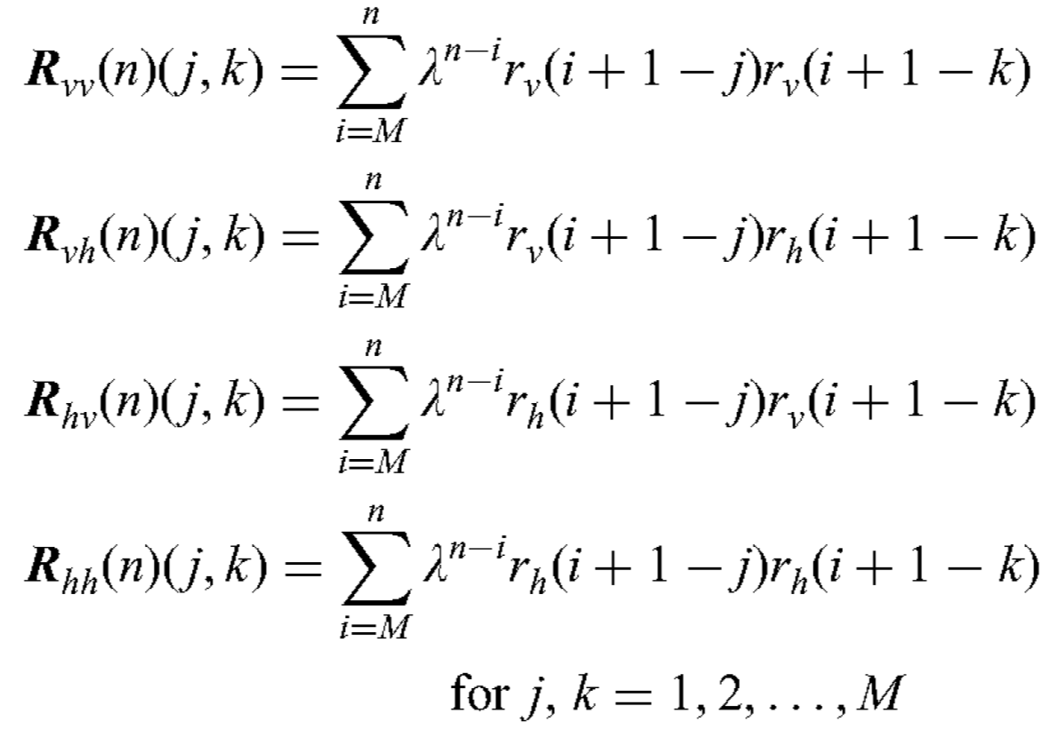
Equivalent Matrix Forms

Slide 18
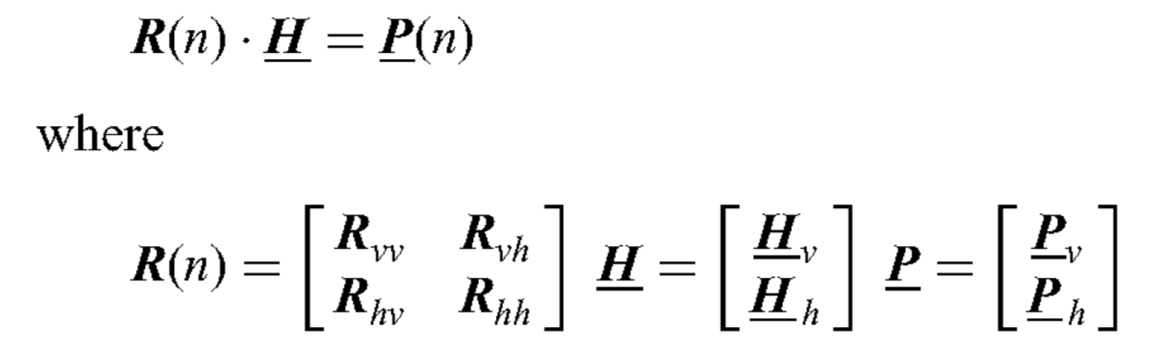
Equivalent Matrix Forms
Removal of Ocular Artifacts from EEG by Adaptive Filtering

Slide 19
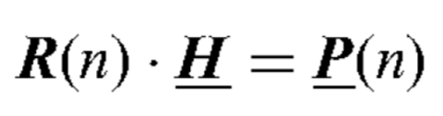
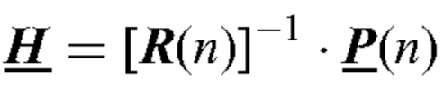
Optimal Filter Coefficients
Coefficient Optimization is Matrix form is given as
The filter coefficients that minimize Ɛ(n) can be solved as

Slide 20
Problem: Matrix Inversion IS Costly
The filter coefficients that minimize Ɛ(n) can be solved as
Calculating the filter coefficients by directly solving involves matrix inversion, which is computationally expensive.
For a matrix of size NxN, computational complexity in inverting it is N³.

Slide 21
Solution: Use RLS Algorithm
The computation load can be greatly reduced by using a recursive least-squares (RLS) algorithm that calculates the filter coefficients by implementing recursively in n
Now, the above equations are formulated in a recursive manner

Slide 22
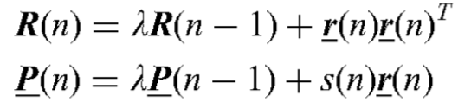
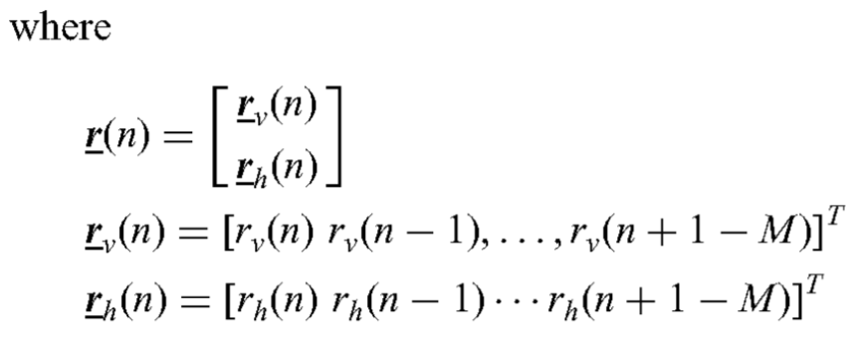
Formulating Recursion
1) Recursion for R(n) and P(n):
Removal of Ocular Artifacts from EEG by Adaptive Filtering

Slide 23
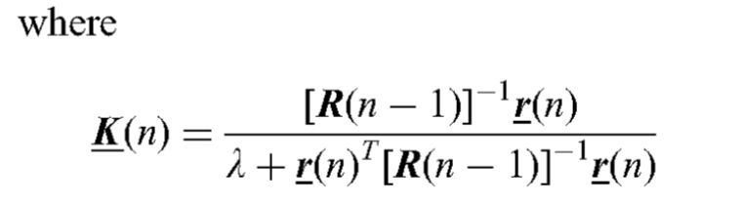
Formulating Recursion (Conti.)
2) We can get [R(n)]⁻¹ using Matrix Inversion Lemma as follows -

Slide 24


Formulating Recursion (Conti.)
3) Using R(n)⁻¹ and P(n) we can write the Filter Coefficient Update Equation as follows -

Slide 25
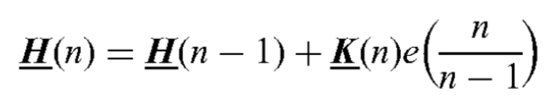


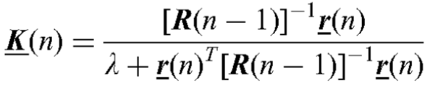
Formulating Recursion (Conti.)
The Filter Coefficient Update Equation as follows: -

Slide 26
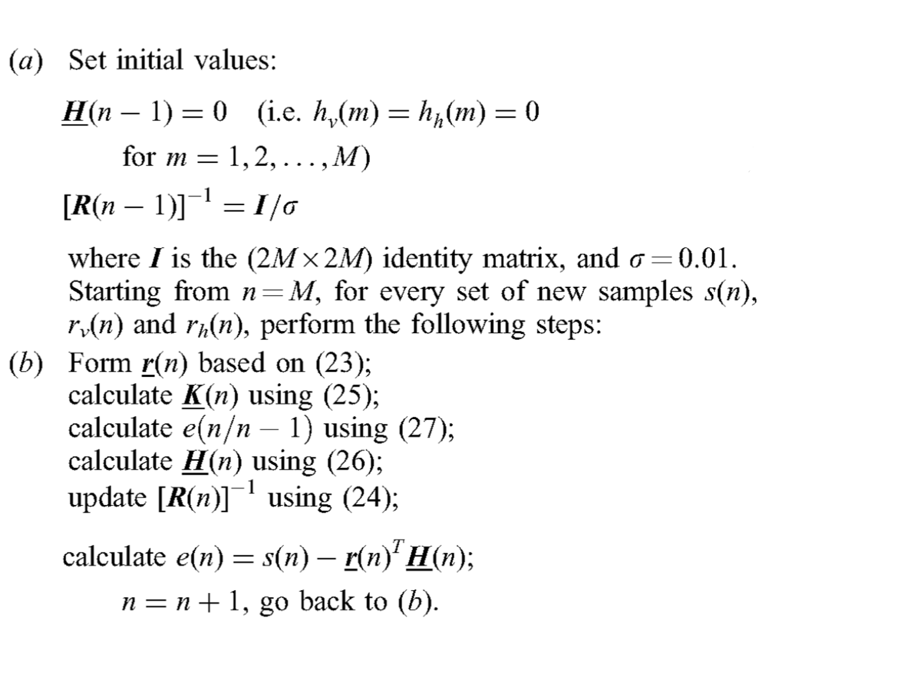
RLS Algorithm Implementation

Slide 27
Table of Content
Introduction
Theory
Project – MATLAB Implementation
Conclusion

Slide 28
Project Idea
Executed the method proposed in the paper “Removal of Ocular artifacts from electro-encephalogram by adaptive filtering” by He et. Al. on MATLAB using another set of data.
The main objective was to verify the claims made by author regarding the ability of the proposed method.

Slide 29
Paper Claims -
This method is easy to implement and stable, converges fast and is suitable for on- line removal of EOG artifacts.
When the filtering algorithm is applied to an EEG recorded at a remote site, e.g. O₂, that contains very few EOG artifacts, the filters are basically shut down and the original EEG simply passes the system without visible changes.
The exact value of λ – “the forgetting factor” is not critical to the performance of the algorithm.
The performance of the adaptive filter is not sensitive to the choice of M: “the filter order”.
As the filter order increases, Mean square error (MSE) decreases.

Slide 30
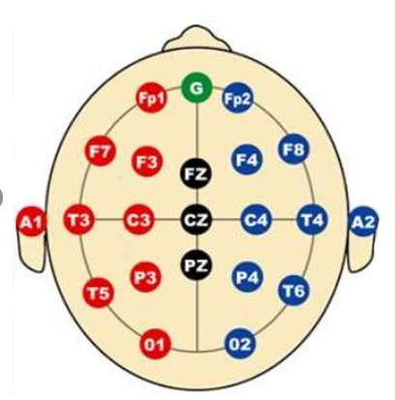
Project DATA
Data published by Manousos Klados and Panagiotis Bamidis.
_https://data.mendeley.com/datasets/wb6yvr725d/3
EEG data was recorded from 3 sites – F_{z}, C_{z}, O₂ positioned according to the international 10-20 Electrode System (JASPER, 1958).
For the EOG artifact, only one reference signal was used, i.e. HEOG.

Slide 31
Test for Claims 1
Claim: “This method is easy to implement and stable, converges fast and is suitable for on-line removal of EOG artifacts”.
Approach: Executed this method for raw data from electrode at F_{z}
Code:
Notes:
Answer Alberto’s question regarding Invertibility of R

Slide 32
Test for Claims 2
Claim: “When the adaptive filtering algorithm is applied to an EEG recorded at a remote site, e.g. O₂, that contains very few EOG artifacts, the filters are basically shut down and the original EEG simply passes the system without visible changes”.
Approach: Executed this method for raw data from other electrodes: C_{z} and O₂ and compared the output with data from F_{z}.
Code:
Notes:
E does the deed

Slide 33
Test for Claims 3
Claim: The exact value of λ, i.e. “ the forgetting factor” is not critical to the performance of the algorithm.
Approach: Executed the algorithm with 3 different λ values : λ₁ = 0.9999 (original),
λ₂ = 0.995,
λ₃ =1,
and compared their responses.
Code:

Slide 34
Test for Claims 4
Claim: The performance of the adaptive filter is not sensitive to the choice of M, i.e. “filter order”.
Approach: Executed the algorithm with 3 different M values : M₁ = 3 (original),
M₂ = 1,
M₃ = 12,
and compared their responses.
Code:

Slide 35
Test for Claims 5
Claim: As the filter order increases, MSE monotonically decreases.
Approach: Executed the algorithm with 3 different M values : M₁ = 3 (original),
M₂ = 1,
M₃ = 12,
and calculated the MSE for each.
Code:

Slide 36
Table of Content
Introduction
Theory
Project
Conclusion – Ending notes

Slide 37
Conclusion: Claims Verified
By carefully comparing the waveforms of the corrected EEG( b) and the original EEG(a), we can see that the algorithm effectively removes EOG artifacts, while largely preserving the original waveform when there is almost no EOG interference.
When the adaptive filtering algorithm is applied to an EEG recorded at a remote site, e.g. P_{z} or 0₂, that contains very few EOG artifacts, the filters are basically shut down automatically (the filter coefficients become very small), and the original EEG simply passes the system without visible changes.
The choice of λ is not critical to the performance of adaptive filter.
The result of adaptive filtering was not very sensitive to the choice of M.
MSE decreases and order of the filter increases

Slide 38
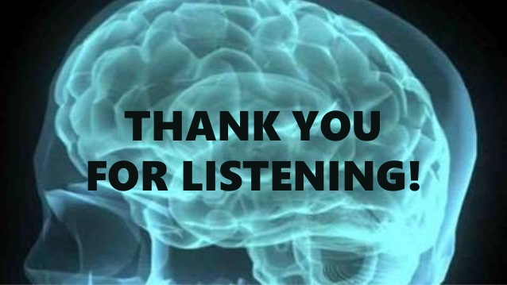
Any Question?

